Slide 1



02/01/2025
PROJECT
BRIEF DECK
Autonomous Infrared-Based Human Detection and Navigation Robot for Post-Disaster Search and Rescue
GROUP MEMBERS
PROJECT SPACE:
MODEL BASE:
Mert Kılınçer
Sümeyra Koç
Ayşe Zülal Yıldız
Gazebo
YOLO

Slide 2


Main problem;
Traditional search and rescue processes are hindered by debris, low visibility and present high risk to human responders.
Our solution;
An autonomous system capable of identifying human signatures under rubble created by the disastrious situations
The impact intended was reducing response time and increasing the accuracy of survivor detection in hazardous conditions.
What Was Our Goal?

Slide 3
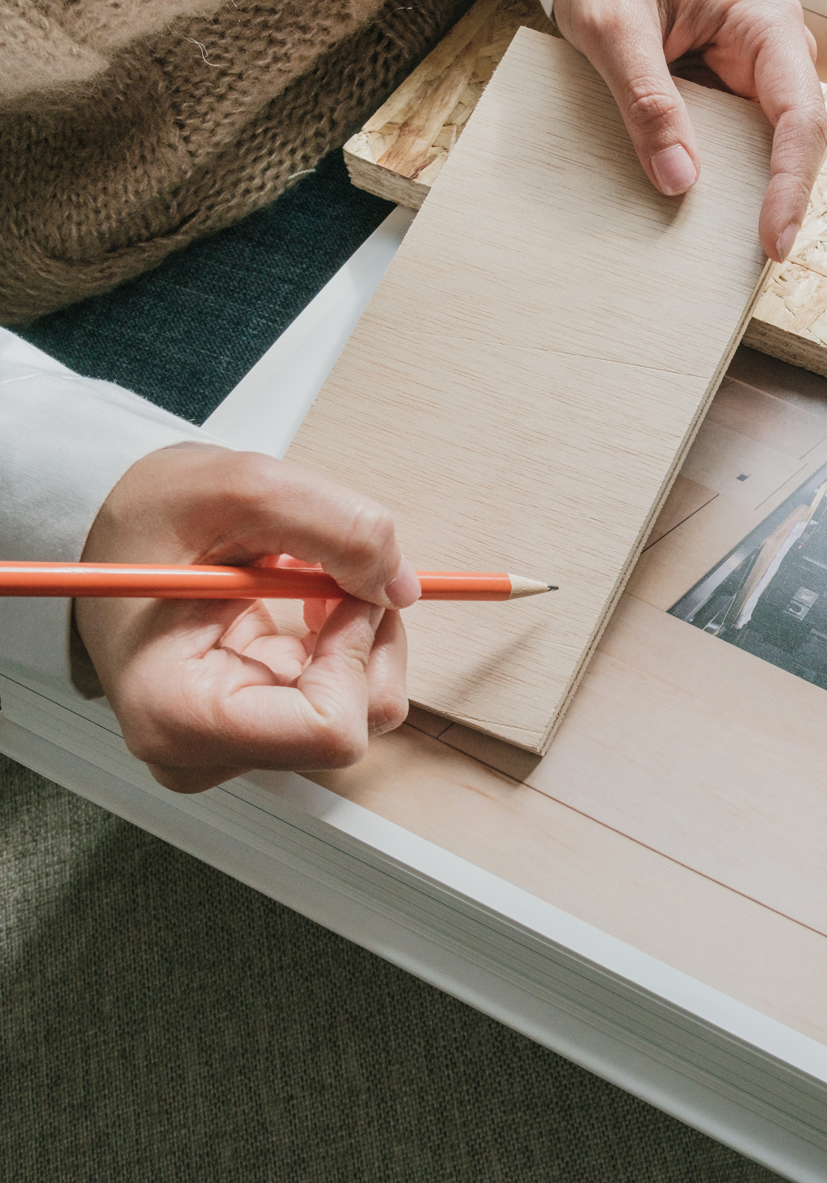
03/10
Term One Objectives
Establishing a safe and cost-effective Gazebo platform to test algorithms.
Training deep learning models (YOLOv8/v11) on infrared datasets.
Implementing Simultaneous Localization and Mapping to navigate unknown environments.
Merging perception and navigation modules within the simulation.

Slide 4

04/10
Current Progress / Perception System
Dual-Camera Architectural Skeleton
RGB Detection Model
Thermal Image Preprocessing
We have successfully trained and deployed a baseline model that detects human figures within the Gazebo simulation using standard RGB imagery.
A framework has been established to handle multi-modal inputs, preparing the system for simultaneous processing of RGB and Infrared (IR) data
We implemented intensity normalization and spatial resizing to prepare IR frames for deep learning inference

Slide 5
05/10
Current Progress / Perception System
IR Fusion Experiments
Current Limitations of Fusion
Bounding Box Analysis
We tested a fusion-based model designed to combine spectral data for improved detection.
Experimental results indicated that the fusion model currently performs poorly at close range and fails at long distances due to dataset-specific constraints.
We are currently analyzing discrepancies in bounding box accuracy to refine the alignment between RGB and Thermal spatial coordinates.

Slide 6
06/10
Current Progress / Environment & Sensor Setup
Gazebo Integration
Dual-Sensor Implementation
Camera Switching
The simulation environment now includes debris-filled disaster scenarios and human models for testing with the duckie bot created according to the real robot properties.
We successfully integrated both RGB and IR camera plugins into the robot's URDF/SDF model.
The system now supports switching between RGB and IR feeds, allowing for comparative performance analysis in different visibility conditions.

Slide 7
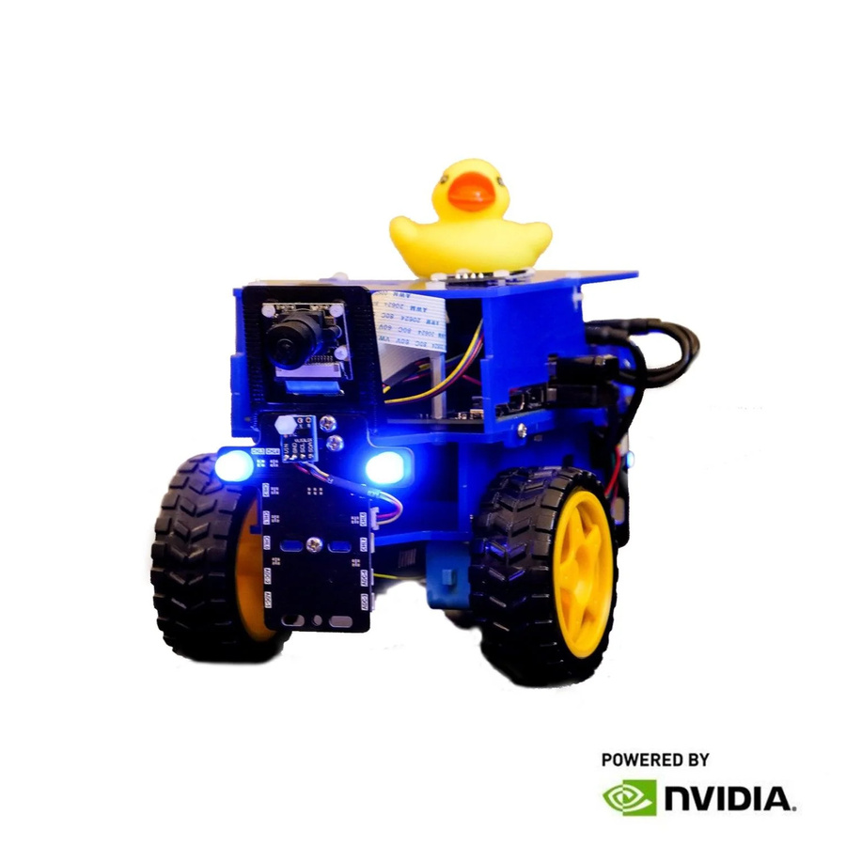
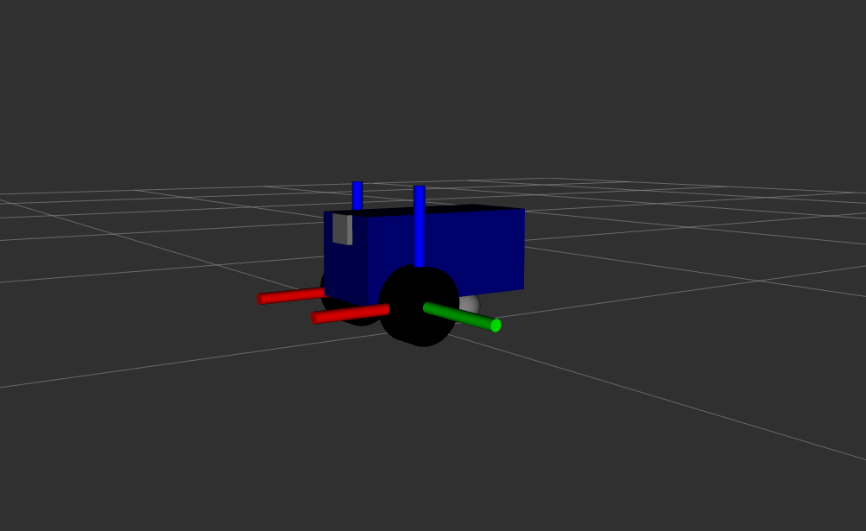
Gazebo Integration
06/10

Slide 8
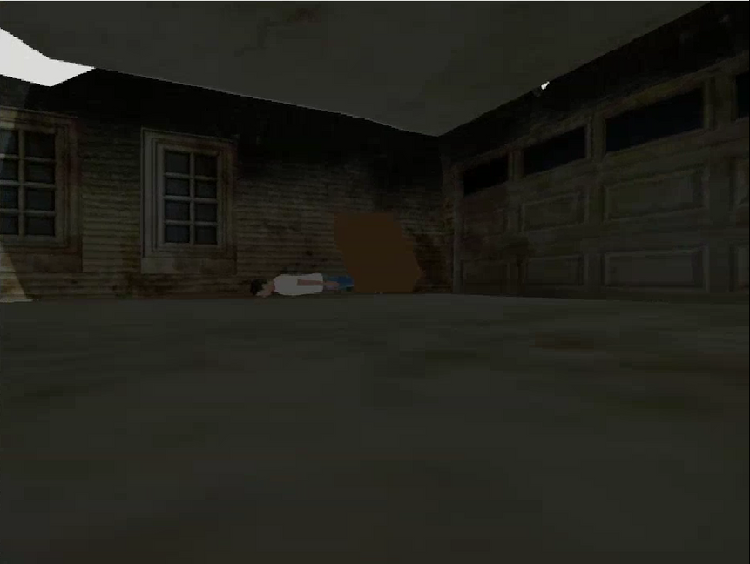
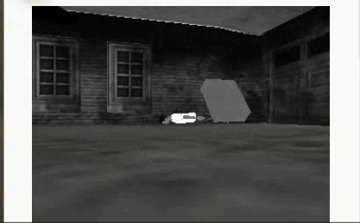
06/10
RGB Camera
IR Camera

Slide 9

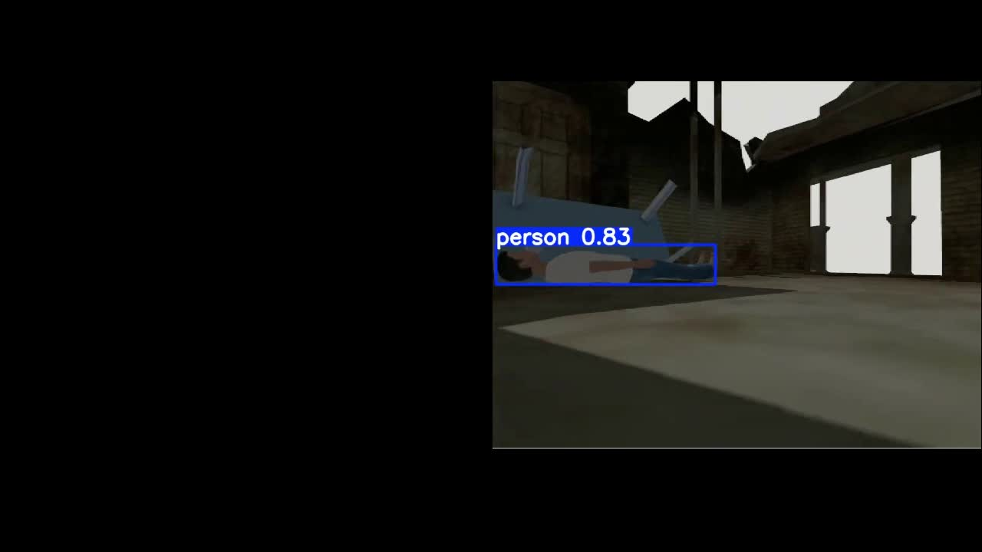
Visual Results with RGB Model
07/10

Slide 10
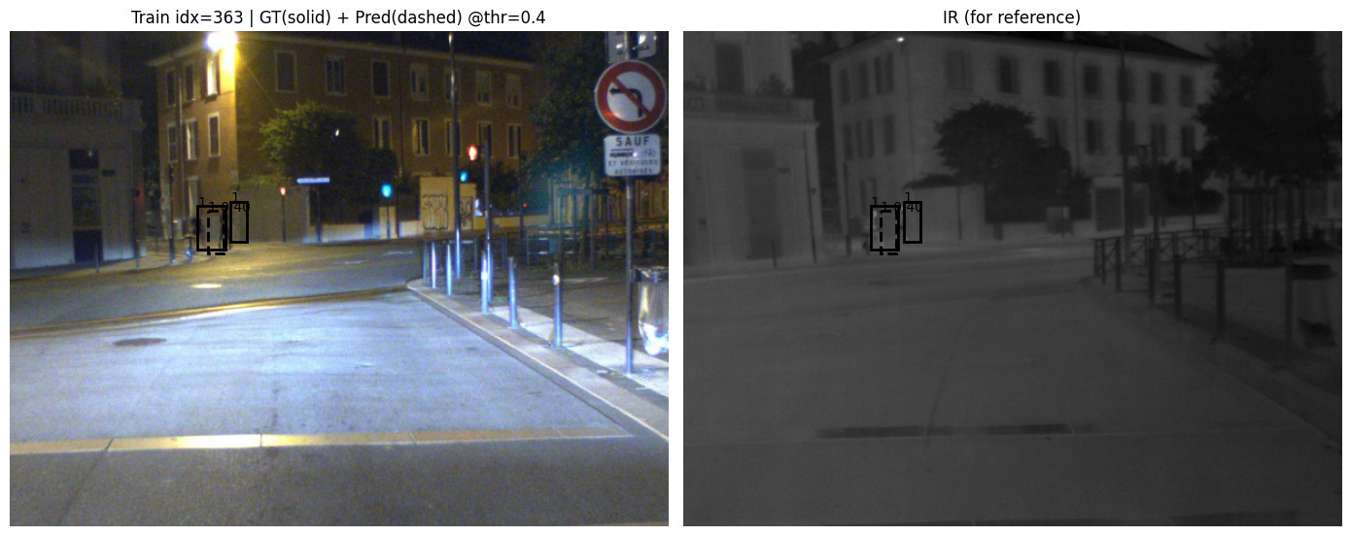
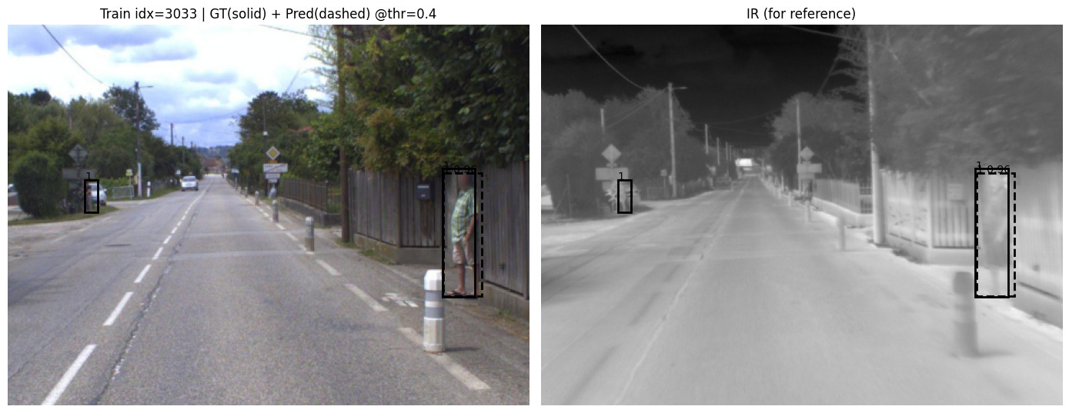
Visual Results with IR Model
08/10

Slide 11
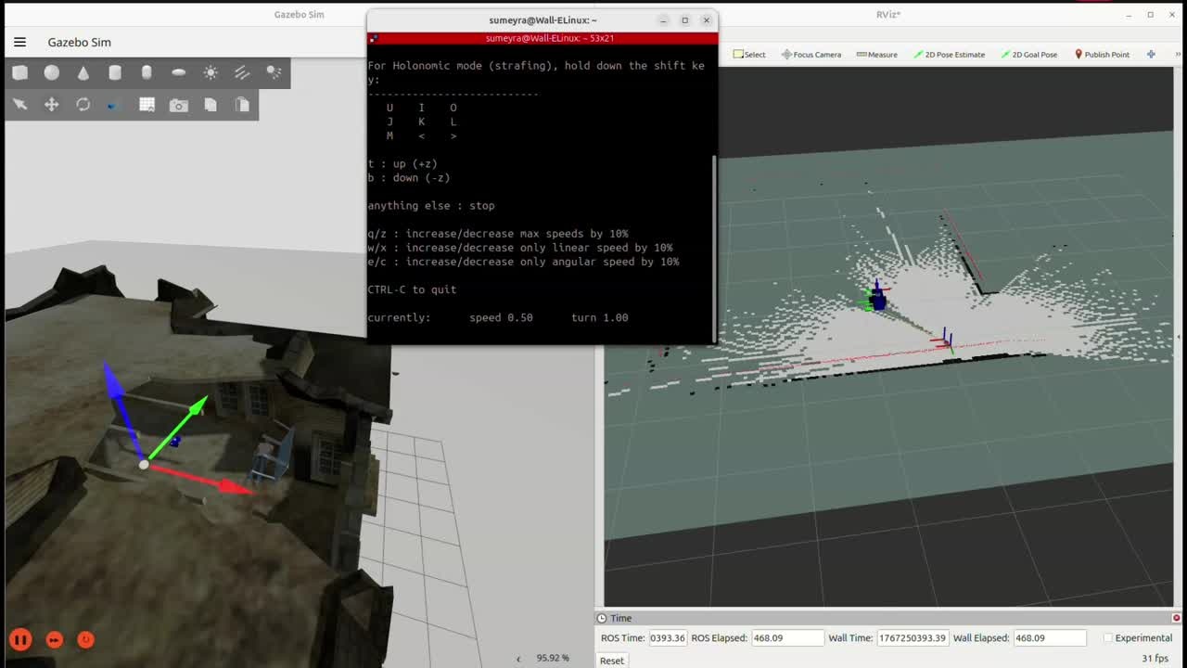
Slam & Path Planning With Lidar Sensor
09/10

Slide 12
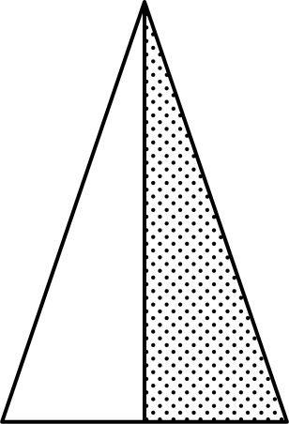
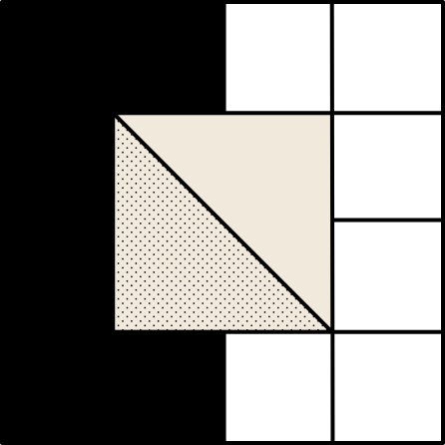
Second Term Plans
10/10
Refining Fusion Models
Reinforcement Learning
Real-Robot Transfer
Web Dashboard Development
Addressing domain transfer issues to improve IR detection at varying distances
Implementing PPO or SAC algorithms to optimize the robot's search path based on detection probability
Calibrating sensors and adapting simulation parameters for deployment on the physical Duckiebot
Finalizing the WebSocket-based interface for live telemetry and multi-user monitoring

Slide 13
Thank you

